Slide 1
Providing Academic Accommodations to Students: It’s more than letters
Shelley Ducatt, Ph.D., P.A.
Associate Dean & Director, Student Disability Resource Center
Florida State University
Jennifer Mitchell
Assistant Director, Student Disability Resource Center
Florida State University

Slide 2
Presentation Outcomes
Gain an understanding of the role and purpose of the SDRC
Ability to discuss the rights, responsibilities, and needs of students with disabilities
List strategies for working with students who have disabilities
Describe actions that individuals and departments can take to ensure that students with disabilities have educational opportunities that are equal to those of their non-disabled peers
Ability to discuss strategies for working with students who have disabilities
Knowledge of campus resources related to students with disabilities

Slide 3
Student Disability Resource Center
As a department in the office of the Dean of Students our mission is to support an inclusive academic environment through education, empowerment, crisis management, and advocacy of students in collaboration with campus and community partners.

Slide 4
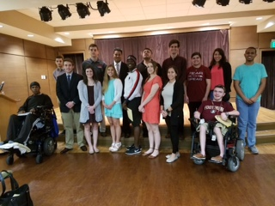
Who are SDRC students?
In 2008, students with disabilities represented nearly 11 percent of all postsecondary students
At Florida State University there are over 3400 students registered with the Student Disability Resource Center
At FSU, the proportion of students reporting AD/HD as their primary disability has increased from 7% to over 32%
Reference: United States Government Accountability Office, 2009, Report GAO-10-33

Slide 5
Florida State University Data
Attention Deficit / Hyperactivity Disorder (AD/HD) 38.2%
Learning Disabilities 22.4%
Psychological Disabilities 14.3%
Chronic Health/Medical Impairments 11.5%
Mobility Impairments 6.7%
Visual Disabilities 2.3%
Deaf/Hard of Hearing 1.5%
Autism Spectrum Disorders 1.8%
Traumatic Brain Injury (TBI) 1.3%

Slide 6
Who Created the ADA Legislative Process?
The Americans with Disabilities Act (ADA) of 1990 was signed by President George H.W. Bush.
“The ADA[…]prohibits discrimination and guarantees that people with disabilities have the same opportunities as everyone else to participate in the mainstream of American life -- to enjoy employment opportunities, to purchase goods and services, and to participate in State and local government programs and services.”
Modeled after:
  the Civil Rights Act of 1964, which prohibits discrimination on the basis of race, color, religion, sex, or national origin – and
  Section 504 of the Rehabilitation Act of 1973, which is a US law prohibiting discrimination based on disabilities.
  (http://www.ada.gov/ada_intro.htm, Nov 4, 2013)

Slide 7
What is the Legislation?
Section 504 of the Rehabilitation Act of 1973 and the Americans with Disabilities Act
  Rehab Act - prohibits discrimination against individuals with disabilities. Section 504 generally prohibits discrimination on the basis of disability in federally funded programs and activities
  ADA Title II prohibits discrimination in access to services or programs of a public entity (this would be a public college or university) and Title III prohibits discrimination in access to places of public accommodation (such as private and public colleges and universities)
Notes:
What is a more accurate title?

Slide 8
What Do These Laws Mean?
In the application of both laws, students with disabilities must be qualified to participate in University activities.
  Specifically, a qualified student with a disability is one who meets the admission and essential eligibility requirements of a program or service, with or without:
    modifications of rules, policies, or procedures,
    removal of architectural, communication, or transportation barriers,
    provision of auxiliary aids and services.
Notes:
To be protected by both laws,

Slide 9
What is a Disability?
An impairment (e.g. AIDS, cancer, bipolar, depression, ADHD, dyslexia, etc.)
This impairment manifests itself so as to substantially (quite significantly but not utterly) limit
A major life activity (something central to daily living – e.g. walking, talking, reading, seeing, hearing, sleeping, procreation, eating, caring for self)
Or, record of or is perceived having the above (three elements)
  Impairment
  That limits substantially
  A major life activity

Slide 10
So What’s the Bottom Line?
“The ADA is an ‘equal opportunity’ law for people with disabilities.”
(http://www.ada.gov/ada_intro.htm, Nov. 4, 2013)
The law does NOT require special treatment of students with disabilities, but does require that students be given the opportunity for equal participation in the University's programs. This is done by providing to eligible and qualified students appropriate academic adjustments and auxiliary aids necessary to facilitate the students’ fullest possible participation in the University’s academic programs.

Slide 11
Responsibility of the Institution
Ensure access to programs, services, and physical spaces (University wide)
Provide reasonable, adequate and required services (University wide)
Establish documentation guidelines (SDRC)
Coordinate services (Collaboration across the University)
Maintain confidentiality (University wide)
Establish and communicate procedures to request services (Collaboration between SDRC, faculty and all academic departments and resource offices)
Educate students, faculty and staff (Collaboration between SDRC and HR)

Slide 12

Responsibility of the Student
Self identify and disclose to the SDRC
Provide complete and up-to-date documentation to the SDRC
Request services as needed for both in class and out of class activities and events
Participate in the process of determining, implementing, and facilitating reasonable accommodations
Abide by student conduct code set by the university and course requirements
Maintain academic standards set by college

Slide 13
Responsibility of the Faculty
Inform students of service/programs: mandatory syllabus statement and verbal reinforcement in class
Collaborate for consideration of course components (essential elements) and student’s functional limitations
Make textbook/syllabus available early
Provide appropriate accommodations as stated in each student’s accommodation letter
Ensure accessibility in the classroom and all offices
Make appropriate referrals
Respect the confidentiality of students
Hold students accountable to established academic standards

Slide 14
What Are Accommodations?
Accommodations provide students with disabilities equal access to the same information as non-disabled students
Accommodations provide students with disabilities the time and opportunity to demonstrate equal mastery of material as
non-disabled students

Slide 15
What is an Accommodation Letter?
An accommodation letter is a legally binding document between the Instructor and the student.
The accommodation letter will contain the list of accommodations that may be provided for the student in the classroom. The student has the right to use all OR some of the student’s approved accommodations in each academic course.
Always contact the Student Disability Resource Center should you have ANY question about how an accommodation should be provided.

Slide 16
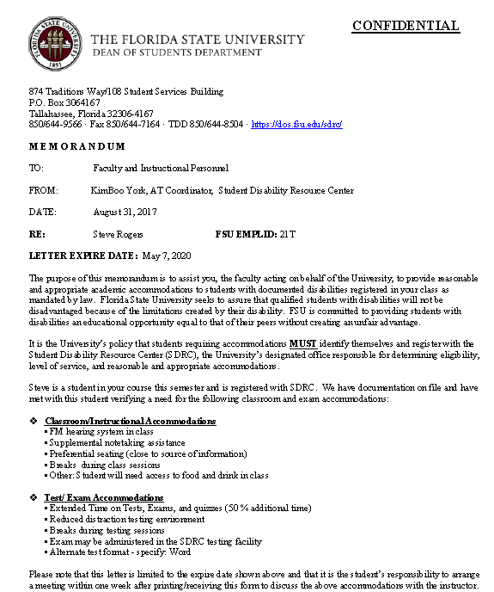

Slide 17
Sample Accommodations
Extended Testing Time
Supplemental Note Taking Assistance
Readers
Scribes
Alternative Text Conversion
Ability to Record Lectures
Sign Language Interpreter
CART Services
Assistive Technology
Reduced Distraction Testing Environment

Slide 18
When Do I Accommodate?
Instructors should only provide accommodations when a student provides an official letter of accommodation from the SDRC.
Accommodation letters will always be on original letterhead and should always have the current semester indicated as well as the student’s full name.
No accommodation should be provided that is not specifically listed on the student’s accommodation letter.
Please ignore all “supplemental” information that may be provided to you by a student…

Slide 19
When Do I Accommodate, cont.
Accommodation letters may be presented at any point during a semester. Keep in mind that an instructor has one week to implement the accommodations from the date it is issued by the student and faculty member.
Accommodations are NOT retroactive.
Student’s MUST meet with their instructor to review the accommodations before the faculty member is required to provide. Accommodation letters may not be left for a faculty member in his/her mailbox, with the office secretary, or under his/her door.

Slide 20
ALL SYLLABI ARE REQUIRED TO INCLUDE THE FOLLOWING STATEMENT:
Americans With Disabilities Act:
Students with disabilities needing academic accommodation should:
(1) register with and provide documentation to the Student Disability Resource Center; and
(2) bring a letter to the instructor indicating the need for accommodation and what type.
This syllabus and other class materials are available in alternative format upon request.
For more information about services available to FSU students with disabilities, contact the:
Student Disability Resource Center
874 Traditions Way
108 Student Services Building
Florida State University
Tallahassee, FL 32306-4167
(850) 644-9566 (voice)
(850) 644-8504 (TDD)
sdrc@fsu.edu
www.dos.fsu.edu/sdrc
http://facsenate.fsu.edu/Curriculum-Resources/syllabus-language

Slide 21
Applying for Services
Students can apply for services after they have been admitted to Florida State University and before the semester they plan to begin study.
Applications can be submitted online via the SDRC Webpage, or by hand at the SDRC main office.
Completed files are reviewed and the student will be contacted by a disability specialist from the SDRC upon review.
You may refer students whom you feel need our services at any time.

Slide 22
Confidentiality
All student information, including documentation that is submitted, is kept confidential and secure according to the Family Educational Rights and Privacy Act (FERPA) guidelines.
Information regarding the student’s accommodations can not be shared with faculty, staff, or parents without written permission.
Faculty and staff must also maintain confidentiality regarding a student’s disability status and approved accommodations.

Slide 23

Can I ask my student if they have a disability?
No
It is the student’s right to disclose his/her disability
You may have to read between the lines of what the student is telling you
Alternative questions:
    Are there any special issues I should be aware of as for this course?
    Do you have specific concerns regarding this course?
    I see you have struggled in… (writing intensive, math, foreign language) …

Slide 24
Emerging Student Populations
Asperger Syndrome
  A student with Asperger Syndrome is a highly functioning student on the Autism Spectrum. Students will struggle the most with appropriate social interactions and maintaining the academic rigors a semester presents.
Post Traumatic Stress Disorders
  Veterans using their new GI Bill money are becoming one of the fastest growing disability populations. These students are often finding that the Veterans Affairs Office is not equipped to help them, and are in fact referring them to the college/university disability services offices. Student Veterans Center at FSU.
Bi Polar Disorder
  With advances in medical treatments available more students with Bi Polar Disorder are able to successfully complete high school and enter college than ever before.

Slide 25
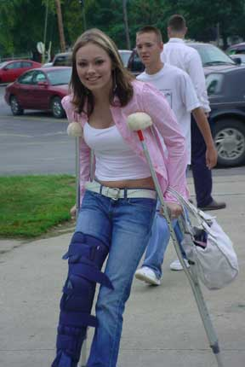
Accessible Van Services
All FSU students who have mobility impairments (temporary or permanent) are eligible to use the FSU Accessible Van
SDRC Accessible Van runs from 7:30am-4:00pm
SDRC Accessible Van service is on campus transportation only

Slide 26
Defining Service Animals
New federal guidelines allow for service animals in the academic classrooms.
  A service animal is defined as a dog (or miniature horse) that is trained to perform a task for a student with a disability that they cannot otherwise perform themselves.
Service animals may be used for disabilities other than visual impairments.

Slide 27
What Can I Ask About a Student’s Service Animal?
Faculty members may only ask two questions to the student prior to the student bringing a service animal into the classroom:
  Is the animal required because of a disability?
  What service or task does the animal provide for you?

Slide 28
Important Things to Know
About Service Animals
Students with service animals do NOT have to register with the Student Disability Resource Center in order to bring the animal into an academic building.
Students are NOT required to submit documentation of a disability or to provide documentation of the service animals training.
Service animals are considered an extension of the student themselves and thus must follow the same conduct code.
The service animal may not be disruptive in the classroom, such as barking or walking around and must be under control at all times. Faculty may ask the student to remove the disruptive animal from the classroom.

Slide 29
Accommodations Regarding Food Allergies
Food allergies are now a protected class under ADA.
Faculty may be asked to make an announcement that food cannot be brought into the classroom due to this.
  In this situation, the faculty member will be provided with a script to read to the class if this is necessary.

Slide 30
General Suggestions for Making Classes Accessible
Create and environment that respects and values diversity. Ensure that the syllabus statement is included and discussed at the beginning of each semester. Invite students to come to speak with you.
Meet with students about their accommodation letters to ensure you are both clear on how the accommodations will be provided for your course.
Have Policies and Procedures for your course in place and stated in the syllabus.
Make sure the facility and your classroom is fully accessible.
Consider alternative methods of administering tests and quizzes

Slide 31
Why use Universal Design principles?
Traditional means of meeting the learning needs of students with disabilities have significant limitations.
  Classroom accommodations, such as extra time on tests or the provision of a notetaker, are typically changes that are retrofitted to a course in order to minimize the impact of the disability.
  UDI offers a proactive alternative for ensuring access to higher education for college students with disabilities.
  When we are able to focus a framework and tools for designing inclusive college instruction, the dialogue surrounding college students with disabilities changes from a focus on compliance, accommodations, and nondiscrimination to an emphasis on teaching and learning.
  Learning environments can never be entirely accessible to all students' needs since some students will continue to need individualized accommodations. But all learning environments can be made more accessible and inclusive.

Slide 32

Guiding Principles of Universal Design of Instruction
Creating a Respectful and Welcoming Climate for Learning
Determining Essential Course Components
Communicating Clear Expectations
Using Diverse Teaching Methods
Providing Natural Supports
Creating Multiple Means for Demonstrating Knowledge
Providing Constructive Feedback
Promoting Interaction
Measuring Outcomes
http://facultyware.uconn.edu/home.cfm

Slide 33
Some ideas for UDI
Interaction
  Make interactions accessible for all participants – example telephone conference calls (can everyone hear and speak? Access issues)
  Encourage cooperative learning – group projects, online discussions, in class discussion, etc.
  Promote effective communication – clarity of information presented, eliminate “razzle dazzle”, use clear straightforward language
Delivery Methods
  Choice of textbooks – well organized, emphasize important points, glossaries, etc. Inclusive language.
  Make content relevant – help by putting things in context, using real life examples, use diverse examples
  Provide cognitive supports – summaries, outlines, power point slides, study guides
  Deliver instructions clearly and in multiple ways – orally and in writing
  Reference: Equal Access: Universal Design of Instruction

Slide 34
Faculty who want to begin incorporating UD principles should consider some of these ideas:
Provide a comprehensive syllabus with clearly identified course requirements, accommodation statement, and due dates
Post lecture notes online.
Share grading rubrics and/or models for written assignments.
Using guided notes enables students to listen for essential concepts without copying notes off of board or overhead
Develop study guides
Provide formative feedback on writing assignments.
Use varied instructional strategies (for example, lectures, videos, guest speakers, group activities) and assessment activities.
Adopt policies and procedures that address accessibility on the front end (for example, guidelines regarding technology that is accessible).

Slide 35
Campus Referral Resources
Adult Learning Evaluation Center (ALEC)
Provides diagnostic testing, accepts campus insurance
2207 Stone Building
Florida State University
(850) 644-3611
Coe-alec@fsu.edu
Psychology Clinic
Provides diagnostic testing
FSU Psychology Department
1107 W. Call St.
(850) 644-3006
http://www.psy.fsu.edu/community/clinic

Slide 36
Campus Referral Resources
University Counseling Center
201 Askew Student Life Building
(850) 644-2003
http://counseling.fsu.edu/
Health and Wellness Center
960 Learning Way
(850) 644-6230
http://healthcenter.fsu.edu/
Academic Center for Excellence (Free Tutoring)
ACE Learning Center at Johnston Ground (WJB)
(850) 645-9151
http://ace.fsu.edu/tutoring

Slide 37
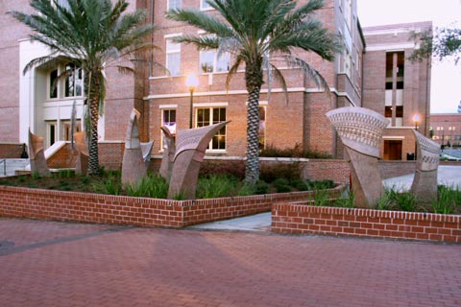
Student Disability Resource Center (SDRC)
874 Traditions Way
108 Student Services Building
(850) 644-9566 (V)
(850) 644-8504 (TDD)
(850) 644-7164 (TTY)
(850) 645-1852 (Fax)
sdrc@fsu.edu
dos.fsu.edu/sdrc

