Slide 1
Providing Academic Accommodations to Students: It’s More Than Letters
Office of Accessibility Services
Dr. Jennifer Mitchell
Assistant Dean/Director
Office of Accessibility Services

Slide 2
Office of Accessibility Services
As an office of the Department of Student Support and Transitions our mission is to collaborate with and empower students, faculty and staff in advancement of an inclusive and universally accessible community that champions the contribution of individuals with disabilities at Florida State University.

Slide 3
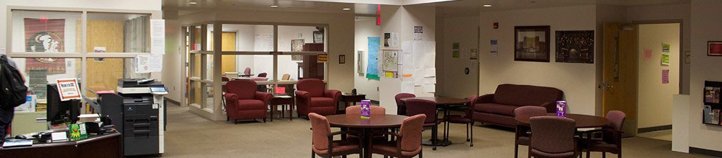
Student Disability Resource Center
The Office of Accessibility Services (OAS) serves as a resource for students, faculty and staff of the university in relation to the provision of accommodations for the unique needs of students both in and out of the classroom.
Through the provision of services the OAS offers an opportunity for all students to achieve their academic and personal goals.

Slide 4
Florida State University Data
*as of January 2020
Attention Deficit / Hyperactivity Disorder (AD/HD) 33%
Psychological Disabilities 24%
Learning Disabilities 15%
Chronic Health/Medical Impairments 15%
Mobility Impairments 7%
Visual Disabilities 2%
Autism Spectrum Disorders 2%
Traumatic Brain Injury (TBI) 1%
Deaf/Hard of Hearing 1%

Slide 5
Who Created the ADA Legislative Process?
The Americans with Disabilities Act (ADA) of 1990 was signed by President George H.W. Bush.
“The ADA[…]prohibits discrimination and guarantees that people with disabilities have the same opportunities as everyone else to participate in the mainstream of American life -- to enjoy employment opportunities, to purchase goods and services, and to participate in State and local government programs and services.”
Modeled after:
  the Civil Rights Act of 1964, which prohibits discrimination on the basis of race, color, religion, sex, or national origin – and
  Section 504 of the Rehabilitation Act of 1973, which is a US law prohibiting discrimination based on disabilities.
  (http://www.ada.gov/ada_intro.htm, Nov 4, 2013)

Slide 6
What is the Legislation?
Section 504 of the Rehabilitation Act of 1973 and the Americans with Disabilities Act
  Rehab Act - prohibits discrimination against individuals with disabilities. Section 504 generally prohibits discrimination on the basis of disability in federally funded programs and activities
  ADA Title II prohibits discrimination in access to services or programs of a public entity (this would be a public college or university) and Title III prohibits discrimination in access to places of public accommodation (such as private and public colleges and universities)
Notes:
What is a more accurate title?

Slide 7
What Do These Laws Mean?
In the application of both laws, students with disabilities must be qualified to participate in University activities.
  Specifically, a qualified student with a disability is one who meets the admission and essential eligibility requirements of a program or service, with or without:
    modifications of rules, policies, or procedures,
    removal of architectural, communication, or transportation barriers,
    provision of auxiliary aids and services.
Notes:
To be protected by both laws,

Slide 8
So What’s the Bottom Line?
“The ADA is an ‘equal opportunity’ law for people with disabilities.”
(http://www.ada.gov/ada_intro.htm, Nov. 4, 2013)
The law does NOT require special treatment of students with disabilities, but does require that students be given the opportunity for equal participation in the University's programs. This is done by providing to eligible and qualified students appropriate academic adjustments and auxiliary aids necessary to facilitate the students’ fullest possible participation in the University’s academic programs.

Slide 9
Episodic Impairments
  An impairment that is episodic or in remission is a disability if it would substantially limit a major life activity when active; and
  An impairment that substantially limits one major life activity need not substantially limit other major life activities in order to be considered a substantially limiting impairment.
  An impairment that is episodic or in remission is a disability if it would substantially limit a major life activity when active

Slide 10
Episodic Impairments
  The symptoms associated with these conditions are often unstable and unpredictable and may be episodic. Conditions referred to by these labels can include:
Autoimmune disorders (lupus, rheumatoid arthritis)
Blood disorders (sickle cell anemia, e.g.)
Caridac disorders
Crohn's disease
Diabetes
HIV/AIDS
Lyme's disease
Post-Traumatic Stress Disorder

Slide 11
What is a Disability?
An impairment (e.g. AIDS, cancer, bipolar, depression, ADHD, dyslexia, etc.)
This impairment manifests itself so as to substantially (quite significantly but not utterly) limit
A major life activity (something central to daily living – e.g. walking, talking, reading, seeing, hearing, sleeping, procreation, eating, caring for self)
Or, record of or is perceived having the above (three elements)
  Impairment
  That limits substantially
  A major life activity

Slide 12
Responsibility of the Institution
Ensure access to programs, services, and physical spaces (University wide)
Provide reasonable, adequate and required services (University wide)
Establish documentation guidelines (OAS)
Coordinate services (Collaboration across the University)
Maintain confidentiality (University wide)
Establish and communicate procedures to request services (Collaboration between OAS, faculty and all academic departments and resource offices)
Educate students, faculty and staff (Collaboration between OAS and HR)

Slide 13

Responsibility of the Student
Self identify and disclose to the OAS
Provide complete and up-to-date documentation to the OAS
Request services as needed for both in class and out of class activities and events
Participate in the process of determining, implementing, and facilitating reasonable accommodations
Abide by student conduct code set by the university and course requirements
Maintain academic standards set by college

Slide 14
Responsibility of the Faculty
Inform students of service/programs: mandatory syllabus statement and verbal reinforcement in class
Collaborate for consideration of course components (essential elements) and student’s functional limitations
Make textbook/syllabus available early
Provide appropriate accommodations as stated in each student’s accommodation letter
Ensure accessibility in the classroom and all offices
Make appropriate referrals
Respect the confidentiality of students
Hold students accountable to established academic standards

Slide 15
What Are Accommodations?
Accommodations provide students with disabilities equal access to the same information as non-disabled students
Accommodations provide students with disabilities the time and opportunity to demonstrate equal mastery of material as
non-disabled students

Slide 16
What is an Accommodation Letter?
An accommodation letter is a legally binding document between the Instructor and the student.
The accommodation letter will contain the list of accommodations that may be provided for the student in the classroom. The student has the right to use all OR some of the student’s approved accommodations in each academic course.
Always contact the Office of Accessibility Services should you have ANY question about how an accommodation should be provided.

Slide 17
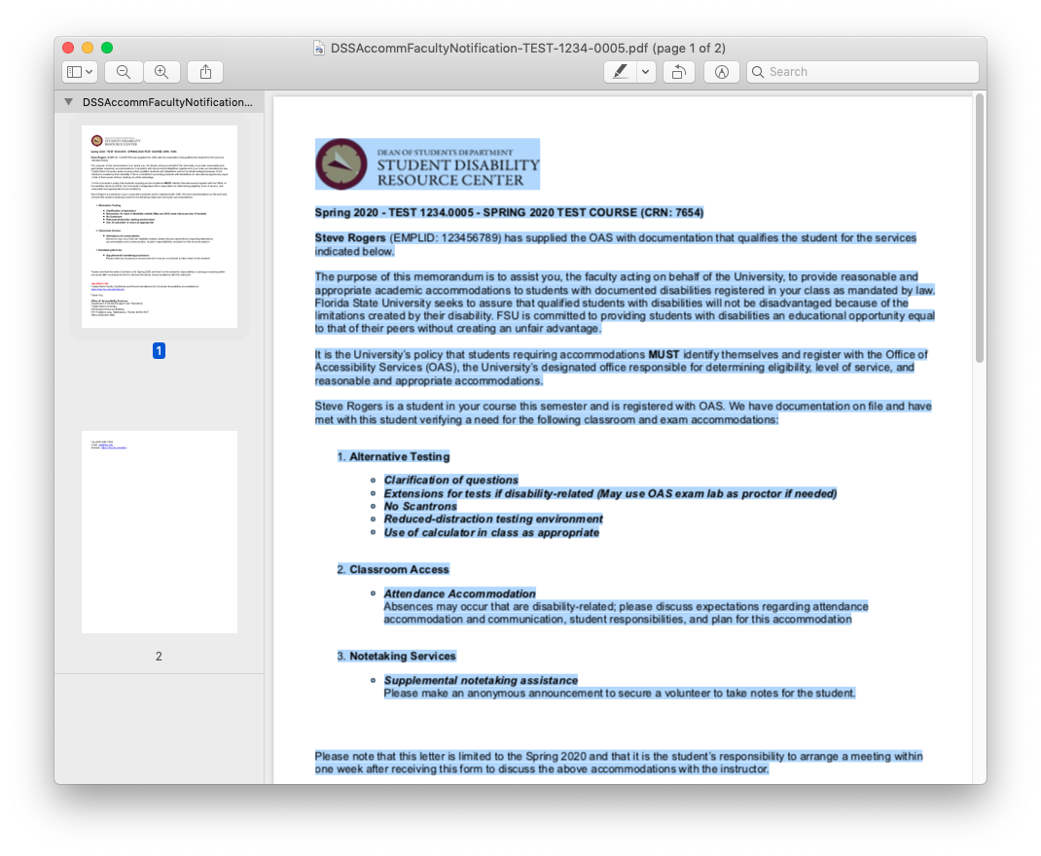
Sample Accommodation Letter

Slide 18
Sample Accommodations
Extended Testing Time
Supplemental Note Taking Assistance
Readers
Scribes
Alternative Text Conversion
Ability to Record Lectures
Sign Language Interpreter
CART Services
Assistive Technology
Reduced Distraction Testing Environment

Slide 19
When Do I Accommodate?
Instructors should only provide accommodations when provided an official letter of accommodation from the SDRC.
Accommodation letters will always be on original letterhead and should always have the current semester indicated as well as the student’s full name.
No accommodation should be provided that is not specifically listed on the student’s accommodation letter.
Do not provide in lieu of accommodations
Please ignore all “supplemental” information that may be provided to you by a student…

Slide 20
When Do I Accommodate, cont.
Accommodation letters may be presented at any point during a semester. Keep in mind that an instructor has one week to implement the accommodations from the date it is issued by the student and faculty member.
Accommodations are NOT retroactive.

Slide 21
ALL SYLLABI ARE REQUIRED TO INCLUDE THE FOLLOWING STATEMENT:
Americans With Disabilities Act:
Students with disabilities needing academic accommodation should:
(1) register with and provide documentation to the Office of Accessibility Services; and
(2) request a letter from the Office of Accessibility Services to be sent to the instructor indicating the need for accommodation and what type.
This syllabus and other class materials are available in alternative format upon request.
For more information about services available to FSU students with disabilities, contact the:
Office of Accessibility Services
874 Traditions Way
108 Student Services Building
Florida State University
Tallahassee, FL 32306-4167
(850) 644-9566 (voice)
(850) 644-8504 (TDD)
oas@fsu.edu
www.dsst.fsu.edu/oas
http://facsenate.fsu.edu/Curriculum-Resources/syllabus-language

Slide 22
Applying for Services
Students can apply for services after they have been admitted to Florida State University and before the semester they plan to begin study.
Applications can be submitted online via the SDRC Webpage
Completed files are reviewed and the student will be contacted by a disability specialist from the SDRC upon review.
You may refer students whom you feel need our services at any time.

Slide 23
Confidentiality
All student information, including documentation that is submitted, is kept confidential and secure according to the Family Educational Rights and Privacy Act (FERPA) guidelines.
Information regarding the student’s accommodations can not be shared with faculty, staff, or parents without written permission.
Faculty and staff must also maintain confidentiality regarding a student’s disability status and approved accommodations.

Slide 24

Can I ask my student if they have a disability?
No
It is the student’s right to disclose his/her disability
You may have to read between the lines of what the student is telling you
Alternative questions:
    Are there any special issues I should be aware of as for this course?
    Do you have specific concerns regarding this course?
    I see you have struggled in… (writing intensive, math, foreign language) …

Slide 25
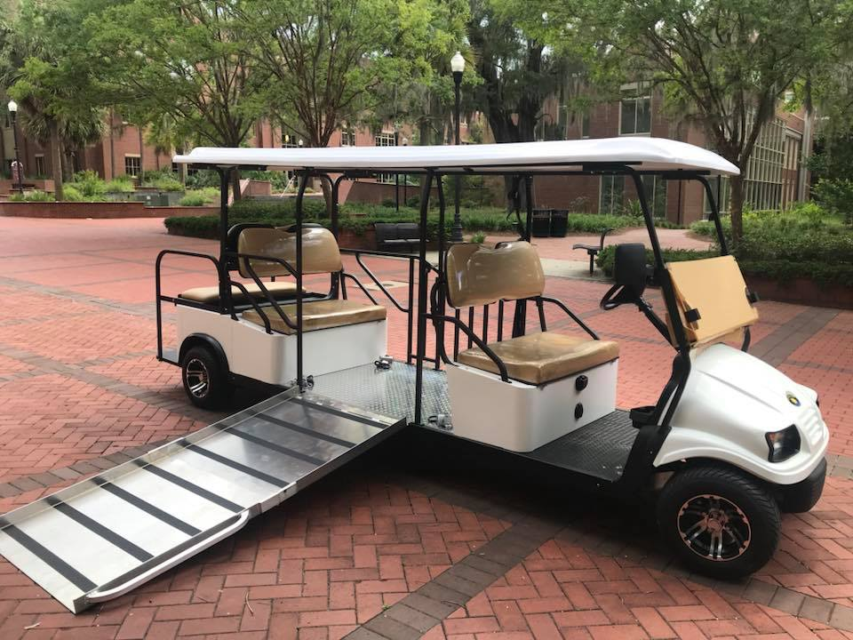
Accessible Transportation Services
All students who have mobility or chronic health issues are eligible to use the FSU Accessible Van and Accessible Golf Cart

Slide 26
Defining Service Animals
New federal guidelines allow for service animals in the academic classrooms.
  A service animal is defined as a dog (or miniature horse) that is trained to perform a task for a student with a disability that they cannot otherwise perform themselves.
Service animals may be used for disabilities other than visual impairments.

Slide 27
Important Things to Know
About Service Animals
Students with service animals do NOT have to register with the OAS in order to bring the animal into an academic building.
Students are NOT required to submit documentation of a disability or to provide documentation of the service animals training.
Service animals are considered an extension of the student themselves and thus must follow the same conduct code.
The service animal may not be disruptive in the classroom, such as barking or walking around and must be under control at all times. Faculty may ask the student to remove the disruptive animal from the classroom.

Slide 28
Emotional Support Animals
Emotional Support Animals (ESAs) are not considered service animals under the Americans with Disabilities Act.
These support animals provide companionship, relieve loneliness, and sometimes help with psychiatric disabilities and mental impairments, such as depression, anxiety, and certain phobias; however, unlike service animals, ESAs do not have special training to perform specific tasks to assist people with disabilities.
ESAs only pertain to a student’s dwelling and may not be taken to class.
If a student needs to request an ESA accommodation, they must register with the OAS

Slide 29
Accommodations Regarding Food Allergies
Food allergies are a protected class under ADA.
Faculty may be asked to make an announcement that food cannot be brought into the classroom due to this.
Students are connected through the OAS with Seminole Dining connection to ensure all dietary needs are met.

Slide 30
Accommodations Regarding Food Allergies
Food allergies are now a protected class under ADA.
Faculty may be asked to make an announcement that food cannot be brought into the classroom due to this.
  In this situation, the faculty member will be provided with a script to read to the class if this is necessary.

Slide 31
General Suggestions for Making Classes Accessible
Create and environment that respects and values diversity. Ensure that the syllabus statement is included and discussed at the beginning of each semester. Invite students to come to speak with you.
Meet with students about their accommodation letters to ensure you are both clear on how the accommodations will be provided for your course.
Have Policies and Procedures for your course in place and stated in the syllabus.
Make sure the facility and your classroom is fully accessible.
Consider alternative methods of administering tests and quizzes

Slide 32

Guiding Principles of Universal Design of Instruction
Creating a Respectful and Welcoming Climate for Learning
Determining Essential Course Components
Communicating Clear Expectations
Using Diverse Teaching Methods
Providing Natural Supports
Creating Multiple Means for Demonstrating Knowledge
Providing Constructive Feedback
Promoting Interaction
Measuring Outcomes
http://facultyware.uconn.edu/home.cfm

Slide 33
Faculty who want to begin incorporating UD principles should consider some of these ideas:
Provide a comprehensive syllabus with clearly identified course requirements, accommodation statement, and due dates
Post lecture notes online.
Share grading rubrics and/or models for written assignments.
Using guided notes enables students to listen for essential concepts without copying notes off of board or overhead
Develop study guides
Provide formative feedback on writing assignments.
Use varied instructional strategies (for example, lectures, videos, guest speakers, group activities) and assessment activities.
Adopt policies and procedures that address accessibility on the front end (for example, guidelines regarding technology that is accessible).

Slide 34
Summary
Language is very powerful. Please think about the words you use and ensure that inclusive language is modeled within your course.
Confidentiality is required under ADA and must be maintained at all times.
Enrollment with the OAS is ongoing. Students can register at any time during the semester. The faculty member has one week from when the student presents to letter of accommodation and meets to discuss his/her accommodations to have the accommodations implemented.
Individuals have both obvious and non obvious disabilities, never assume.

Slide 35

Office of Accessibility Services (OAS)
874 Traditions Way
108 Student Services Building
(850) 644-9566 (V)
(850) 644-8504 (TDD)
(850) 644-7164 (TTY)
(850) 645-1852 (Fax)
oas@fsu.edu

